Slide 1
Skeleton-Driven Inbetweening of Bitmap Character Drawings
KIRILL BRODT and MIKHAIL BESSMELTSEV
Université de Montréal, Canada
Notes:
Hello, I am Kirill and I’m presenting Skeleton-Driven Inbetweening of Bitmap Character Drawings. Work done along with Mikhail Bessmeltsev at the Universite de Montreal.

Slide 2
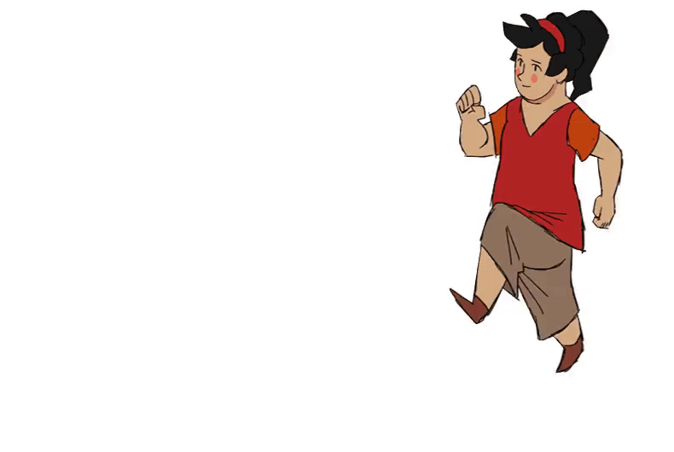
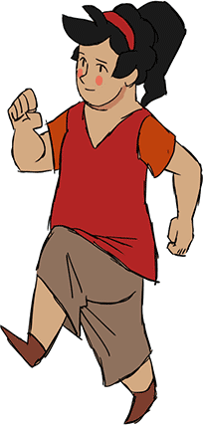
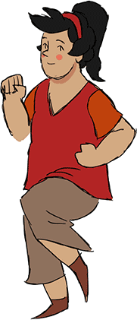
Inbetweening
Input frame A
Input frame B
Notes:
Inbetweening is an important part of the traditional 2D animation pipeline. To create an animated motion, [first], the principal artist draws key frames capturing the main poses and then inbetweeners [draw] all the intermediate frames that fill in the motion.
Most importantly, all the intermediate drawings must be very precise creating smooth movement. A typical number of such drawings are counted as millions for one movie. As a result, this manual process requires tremendous resources (рИсорсес), both skilled artists and time.

Slide 3
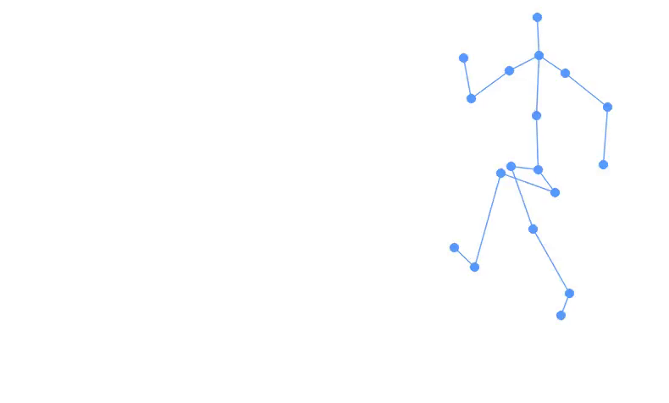
Objective
Far and tight inbetweening
User control
Output
Input frame A
Input motion
Input frame B
Notes:
Our goal here is to automate the character inbetweening process still allowing high-level control of the motion so that the animator (Энэмедор) can be sure that the movement is fluid and lifelike or whatever demand is. [So] to allow for control we require a skeletal motion as an input.
We propose to sidestep this tedious process completely. We introduce the system that [generates] inbetween frames given only two raster drawings. We thus enable animators to create a draft of the animation immediately and automatically from the keyframes.

Slide 4
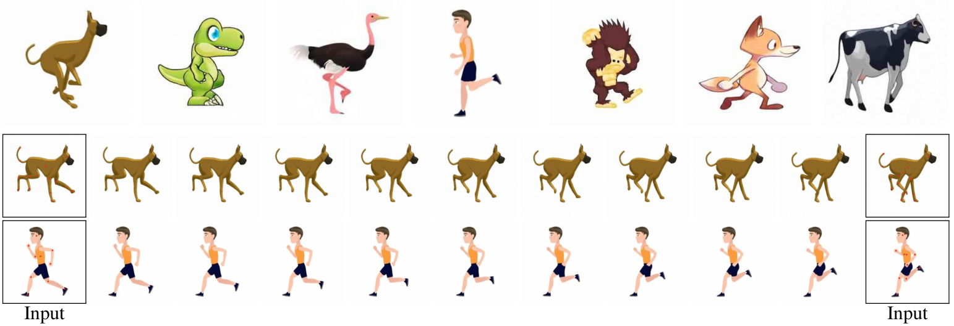
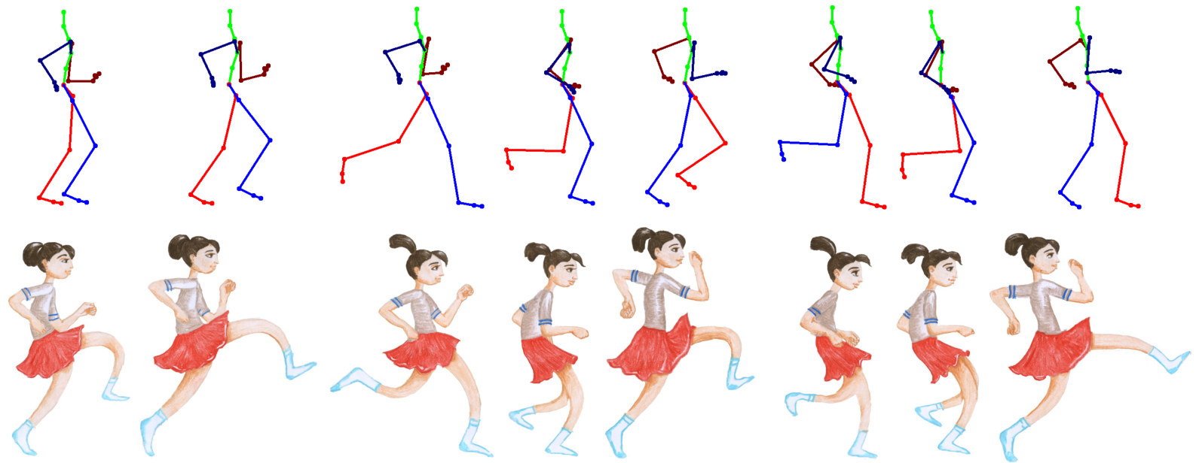
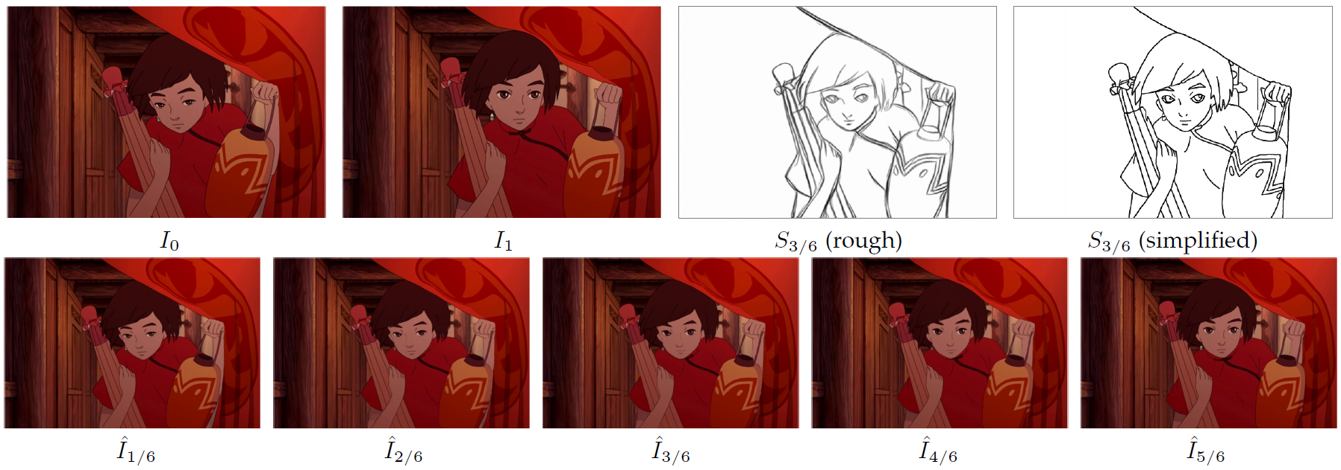
Related work
2023, Siyao, Deep Geometrized
Cartoon Line Inbetweening
2022, Hinz, CharacterGAN: Few-Shot Keypoint Character Animation and Reposing
2021, Xiaoyu Li, Deep Sketch-guided
Cartoon Video Inbetweening
2018, Dvorožnák, ToonSynth: Example-Based Synthesis of Hand-Colored Cartoon Animations
2023, Smith, A Method for Animating Children’s Drawings of the Human Figure
Notes:
Existing automatic solutions for this process are very restricted. For [example] some require two vector drawings. [Another] line of work solving this problem is modern deep learning methods interpolating the two closest video frames in movies. We are inspired by [ToonSynth], which also uses skeletal motion — not for inbetweening, but to drive a single raster drawing.

Slide 5
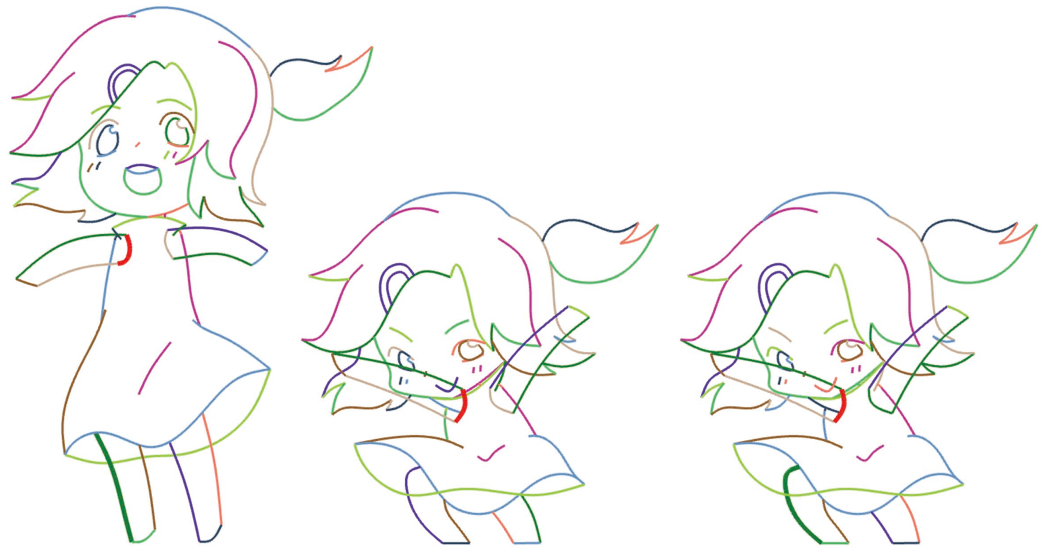
Previous work: clean vector drawings
High-quality vector drawings
Limit the topology of keyframes
2010, Whited, BetweenIT: An Interactive
Tool for Tight Inbetweening
User corrections
Stroke order
2018, Yang, FTP-SC: Fuzzy Topology
Preserving Stroke Correspondence
2024, Mo, Joint Stroke Tracing and
Correspondence for 2D Animation
Notes:
Previous research looked into an option to use [high-quality] vector drawings with [limited] topology or requiring [corrections] from the artist or [stroke] order which are extrEmely hard to get automAtically. Instead, we focus on natural raster drawings.

Slide 6
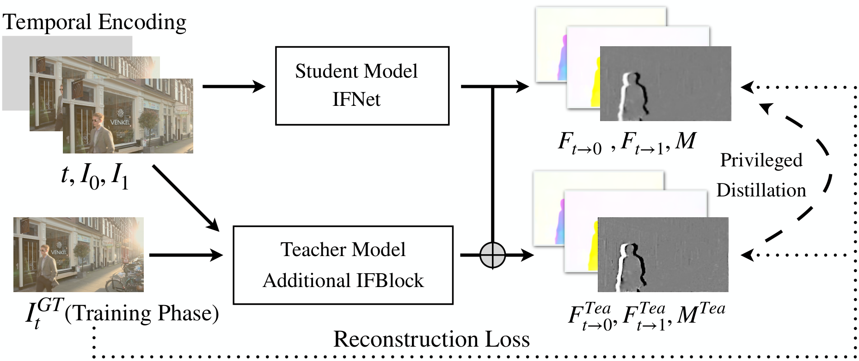
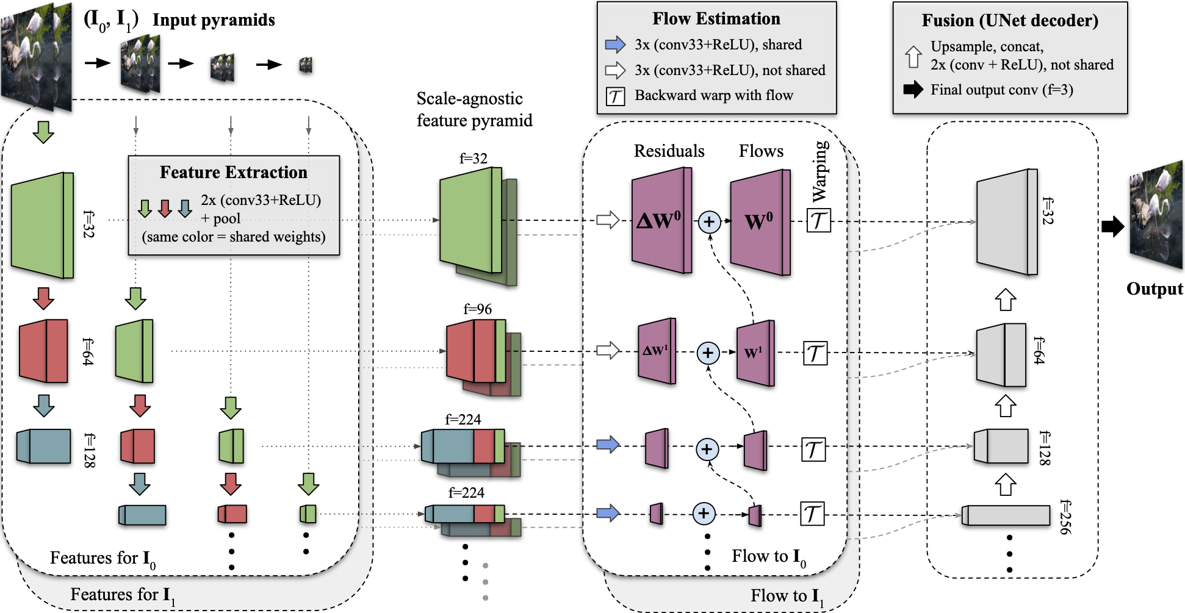
Previous work: frame interpolation
Nearby frames and > 15 fps
2022, Huang, RIFE: Real-Time Intermediate Flow Estimation for Video Frame Interpolation
2022, Reda, FILM: Frame Interpolation
for Large Motion
Notes:
There are alternative works solving this problem by interpolating the two closest video frames in movies. Most of them require datasets with 15 or more fps. But in traditional animation typically the key frames are far apart and doesn’t satisfy the above assumptions.

Slide 7
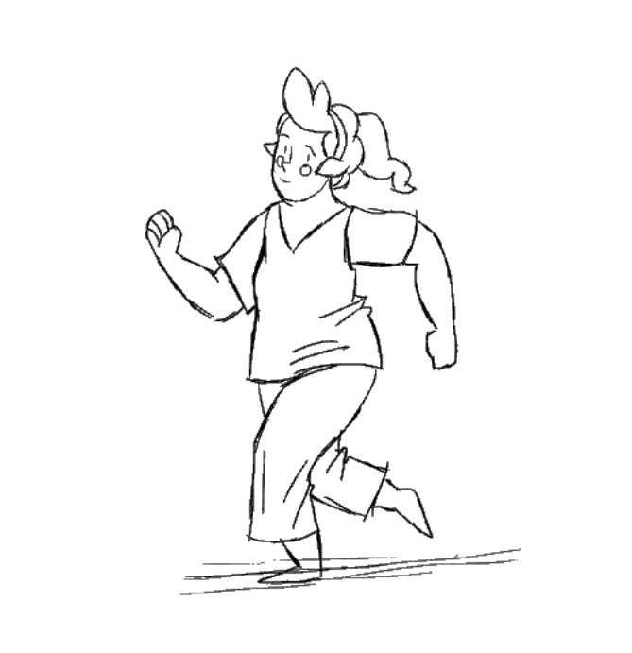
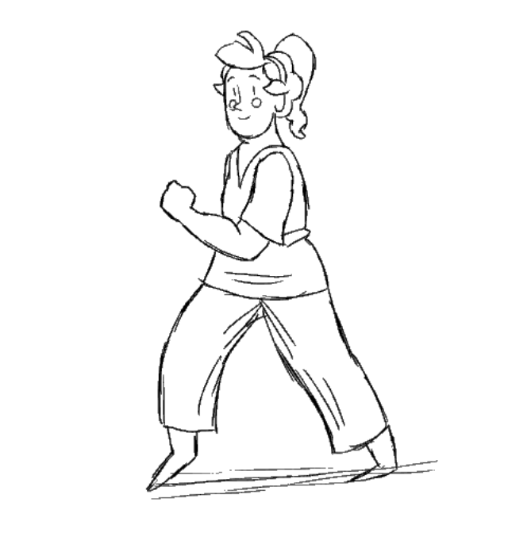
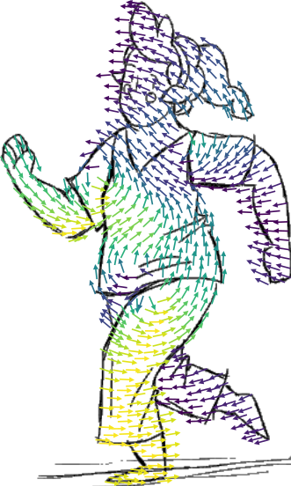
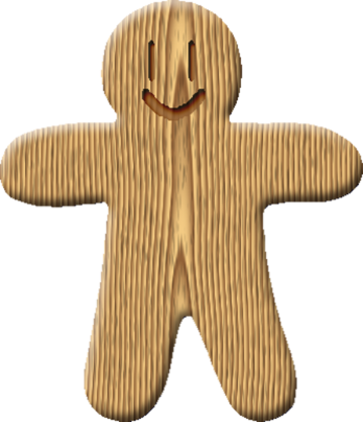
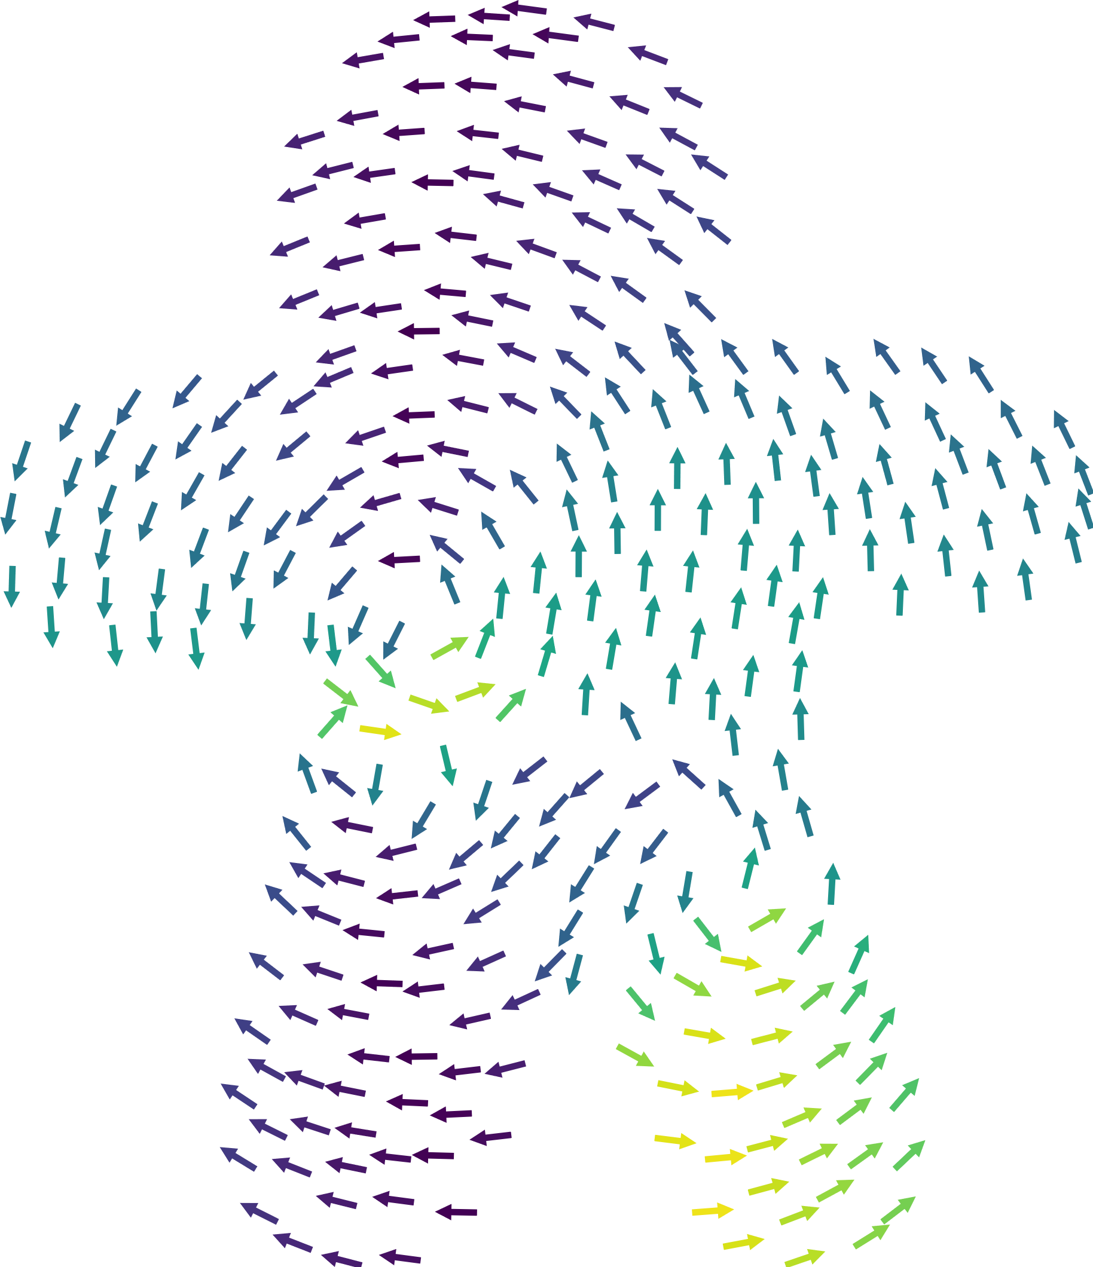
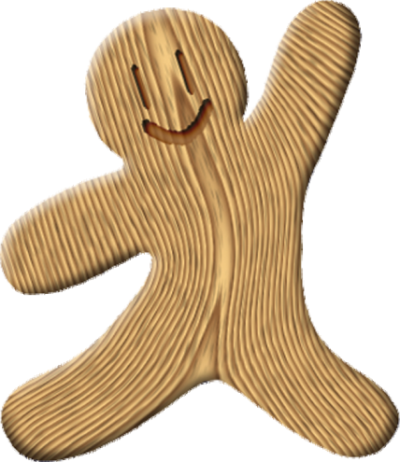
Main challenge: occlusions
?
Input frame A
Input frame B
Input frame A
Input frame B
Notes:
Let’s think about our problem of inbetweening. If the textures on two drawing are the same and the only difference is the pose, then inbetweening is just deformation. If there are no occlusions in the drawing, we can simply deform one keyframe into another using standard 2d deformation tools. [If] you look where each vertex goes this vector field looks smooth.
However, when [occlusions] are present (прЭзэнт), the deformation that we look for becomes [PIECEWISE] smooth. Finding such vector field that deforms first keyframe to the second keyframe is very hard. But [how] can we find it?

Slide 8
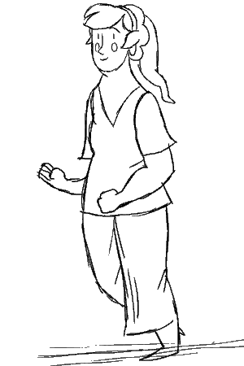
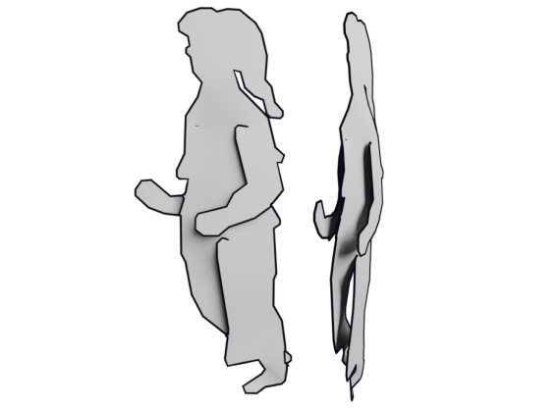
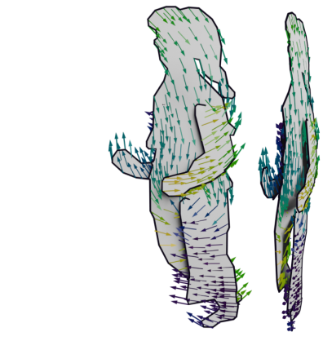
Observation and Idea
Notes:
Instead of looking for that piecewise smooth vector field directly, we observe that this piecewise smooth deformations is a projection of a smooth deformation on some layered domain. So, what we do is we [FIND] such domain or our template such that this deformation field there is [smooth]. In other words we are looking the template such that if we deform it using the skeleton the deformation is smooth.
This layered domain is a 2.5d structure with layers like this. When the smooth deformation field on this domain is projected back onto the plane, it produces the desired piecewise-smooth deformation field.

Slide 9
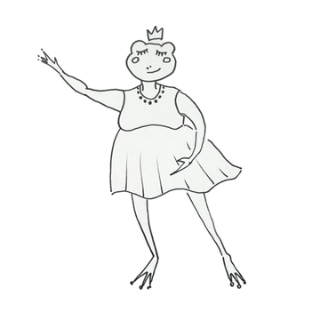
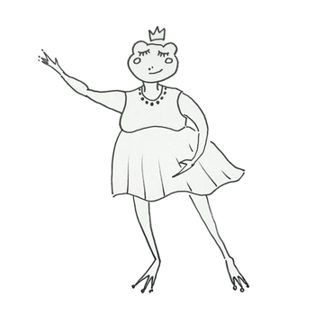
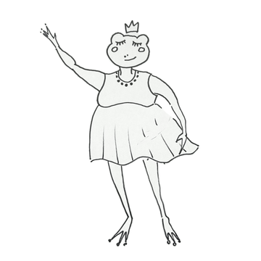
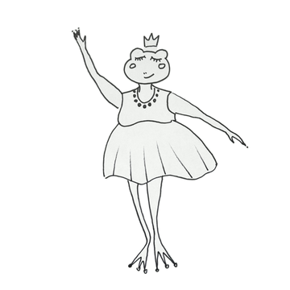
Observation and Idea
Divide animation into skeletal and secondary parts
Explicitly capture skeletal animation via mesh deformation
Secondary deformation modeled by frame interpolation
Input frame A
Skeletal
Secondary
Input frame B
Notes:
Another observation is that we may split the animation into two main parts: [linear] or skeletal animation and [secondary] one. We capture the [linear] part explicitly via deformation of our template. [And] the secondary part is modeled by deep learning frame interpolation.

Slide 10
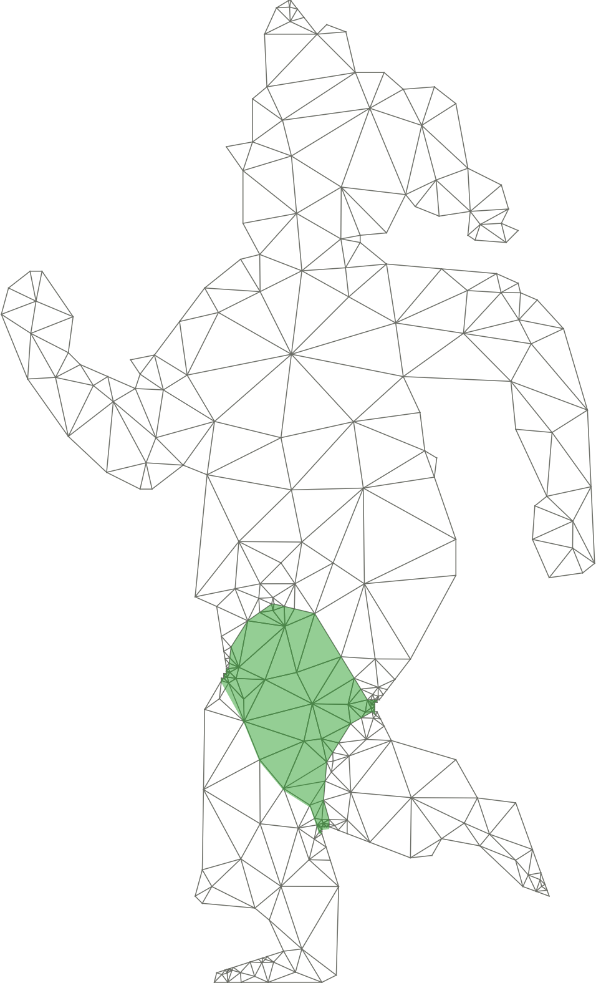
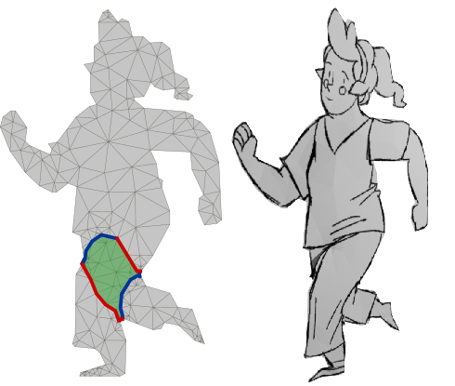
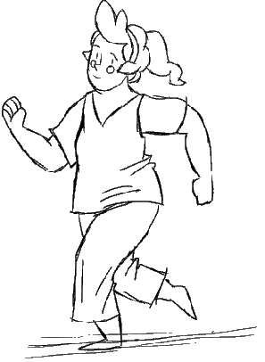
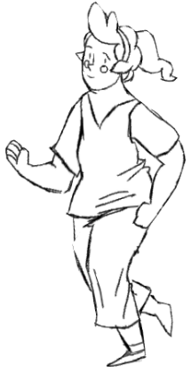
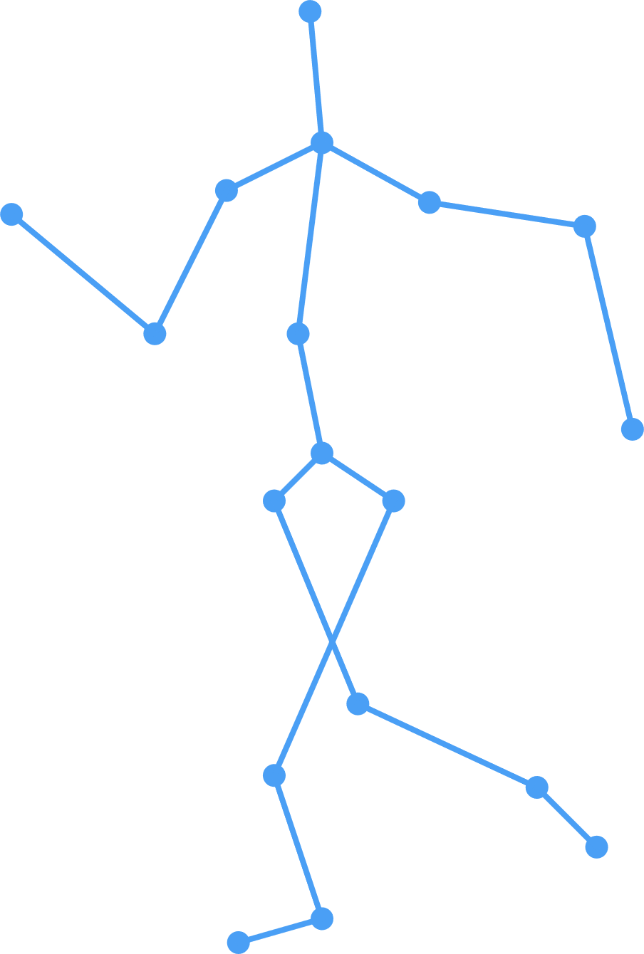
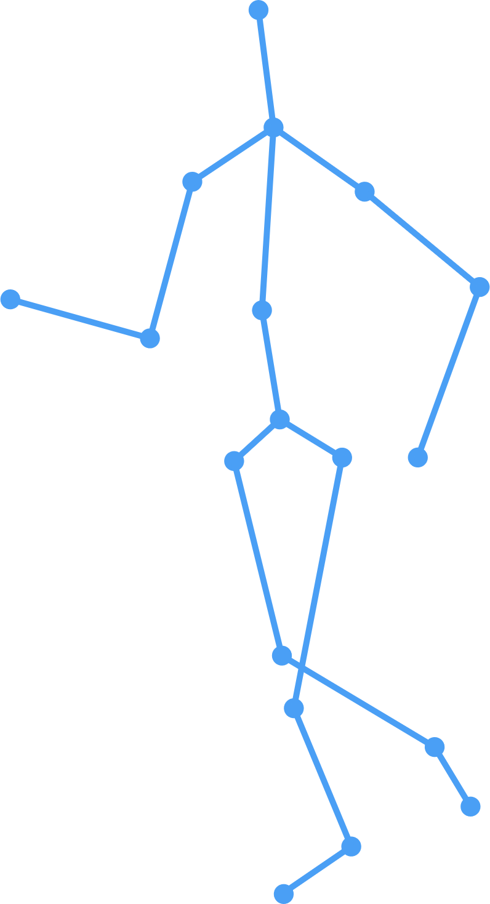
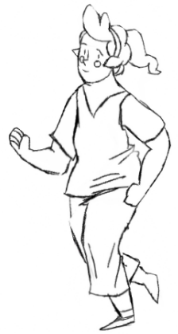
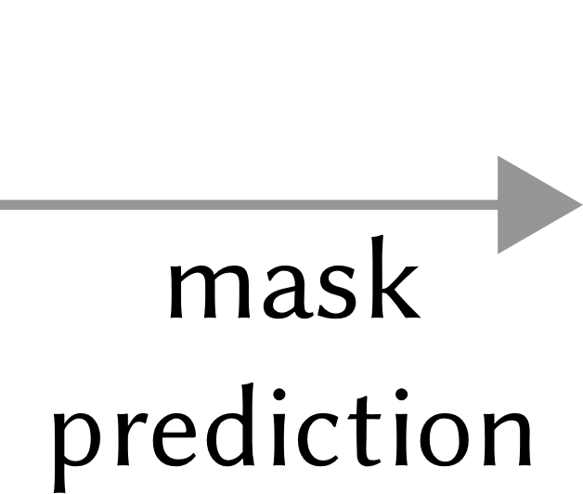
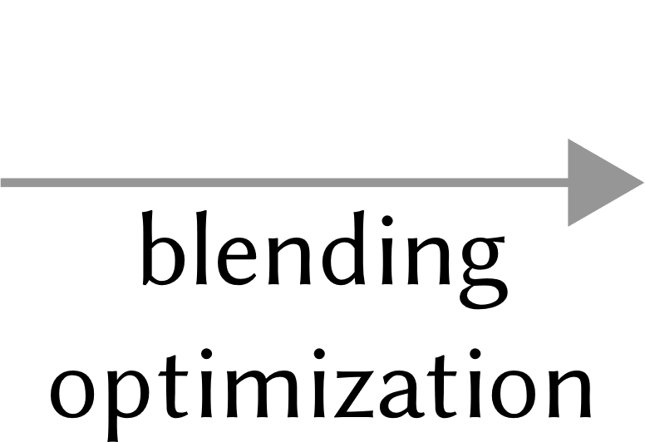
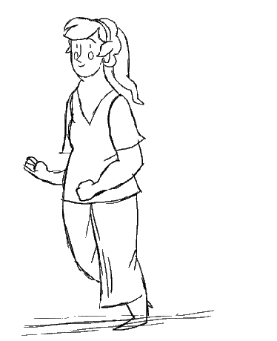
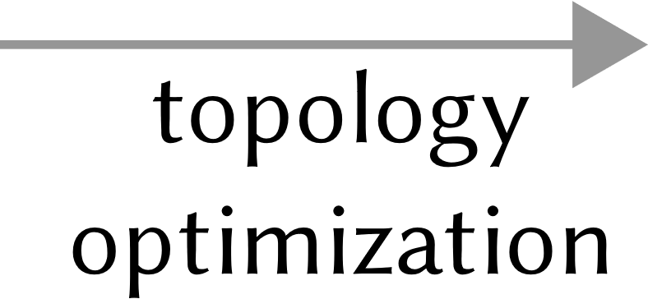
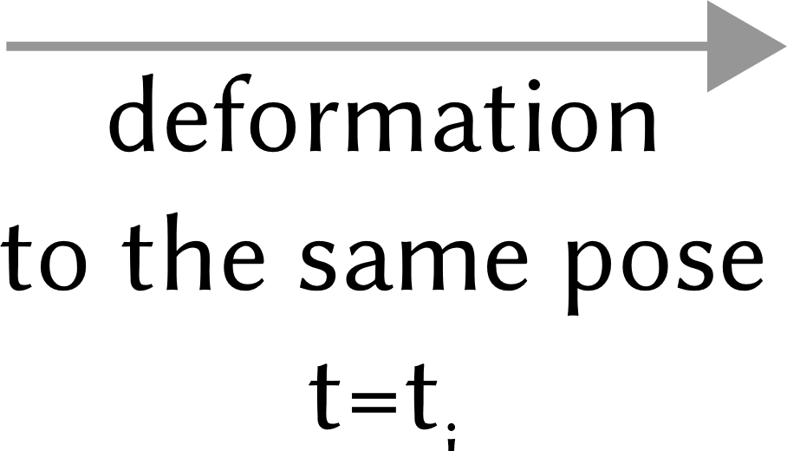
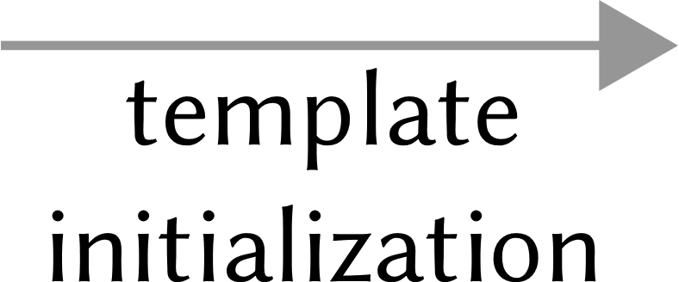
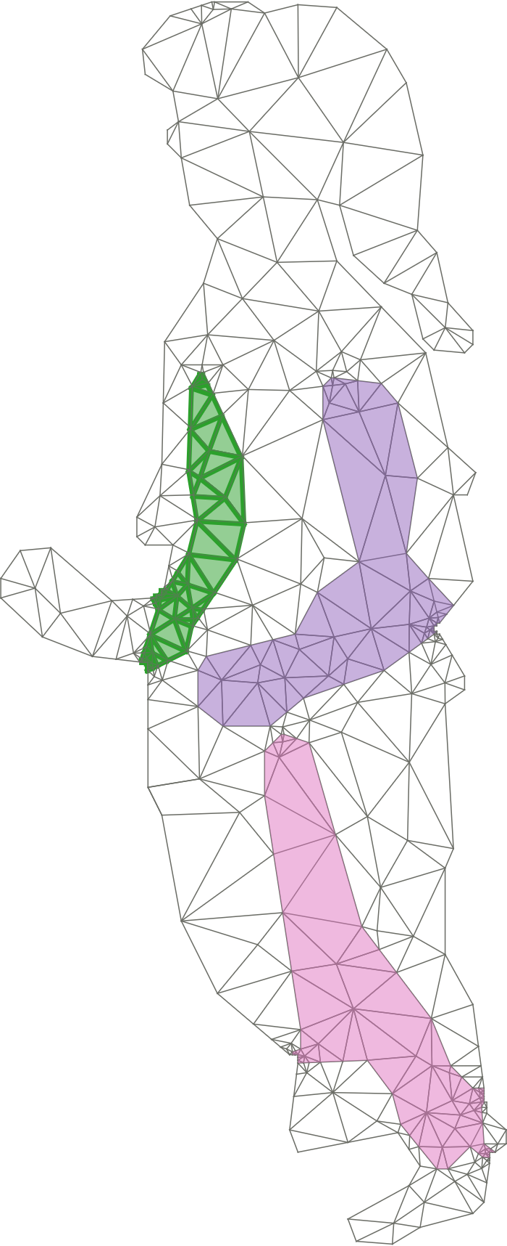
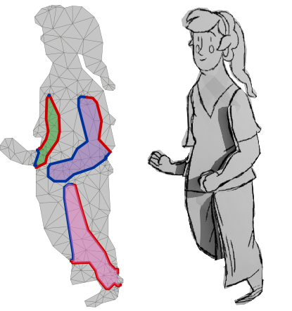
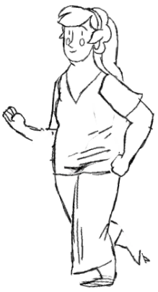
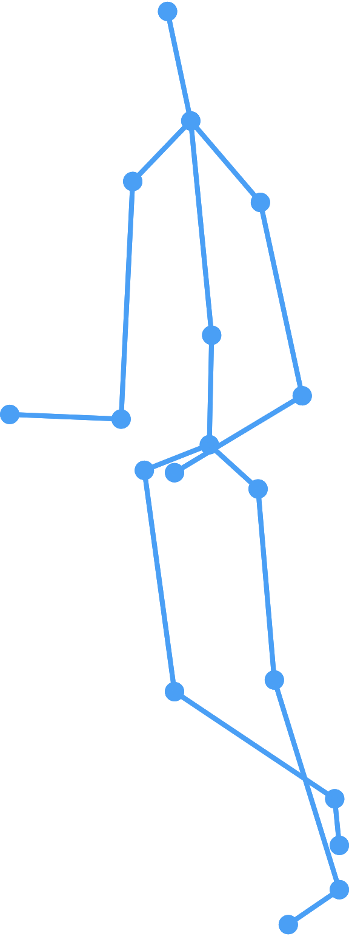
Algorithm overview
Notes:
Let’s take a look at the algorithm [overview].

Slide 11
Algorithm: 2D joints and T-junctions
Predict 2D joints and annotate T-junctions
Notes:
Starting with a pair of bitmap key frames, we ask for [skeletal] annotation or in some cases we predict 2D skeleton. To disambiguate occlusions, [we] also require the user to specify [T-junctions] around the occlusion regions.

Slide 12
Algorithm overview
Notes:
[Then]

Slide 13
Algorithm: occlusion masks
Predict occlusion masks and initialize template
Notes:
We predict [foreground] and [occlusion] masks using a deep neural network. Once the foreground and the occlusion masks are predicted, we [create] the base mesh that will serve as the initialization for our template optimization.

Slide 14
Algorithm overview
Notes:
After [this]

Slide 15
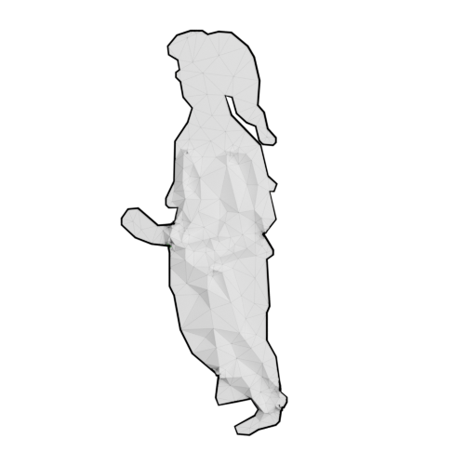
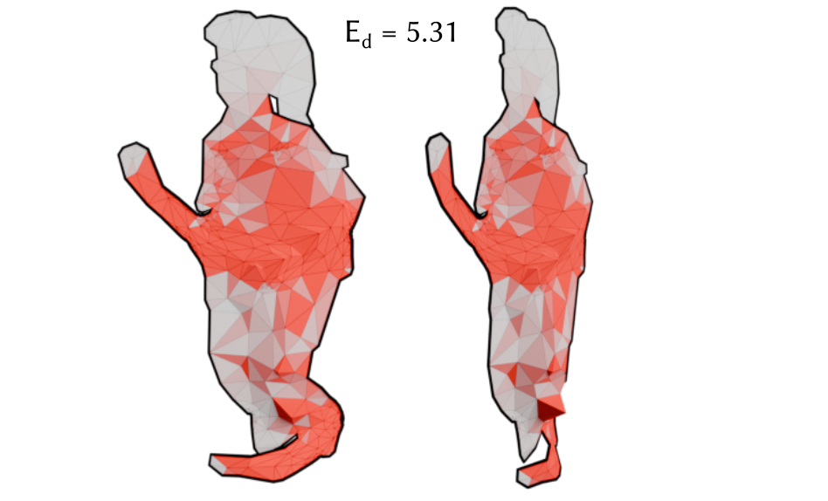
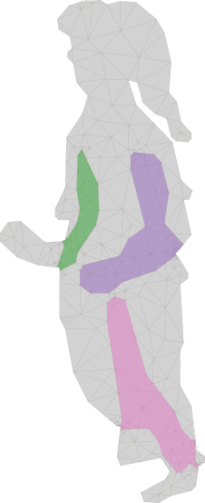
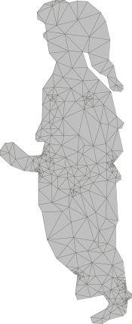
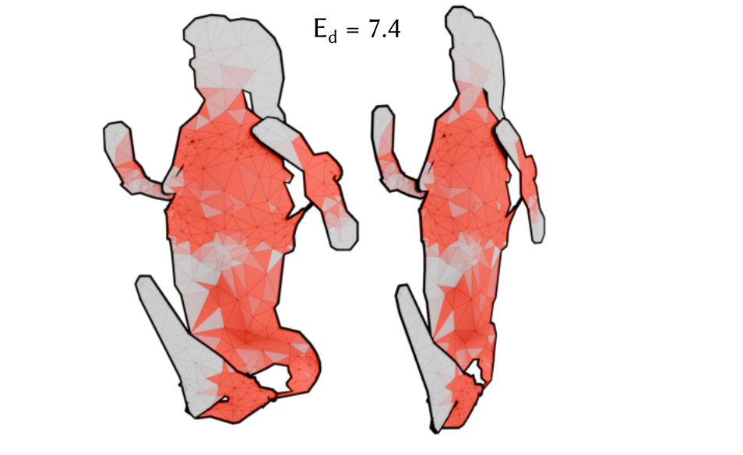
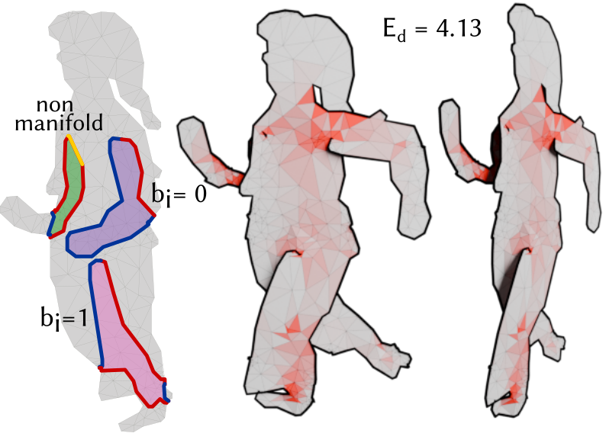
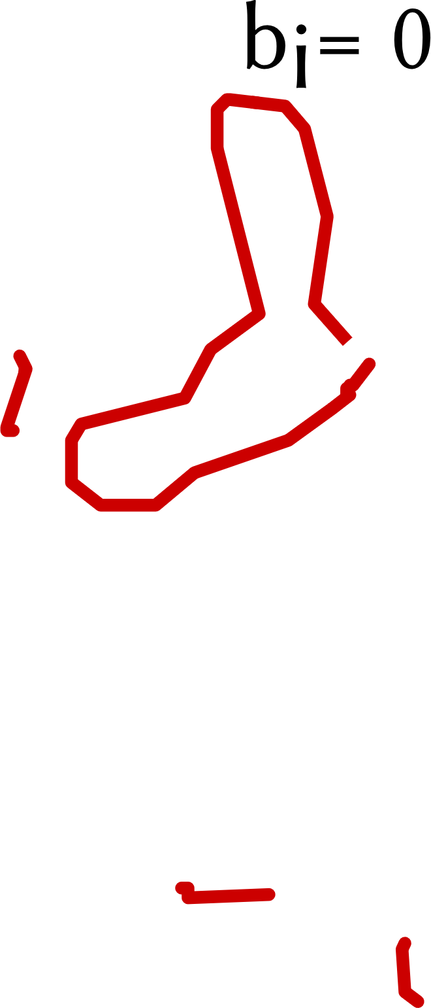
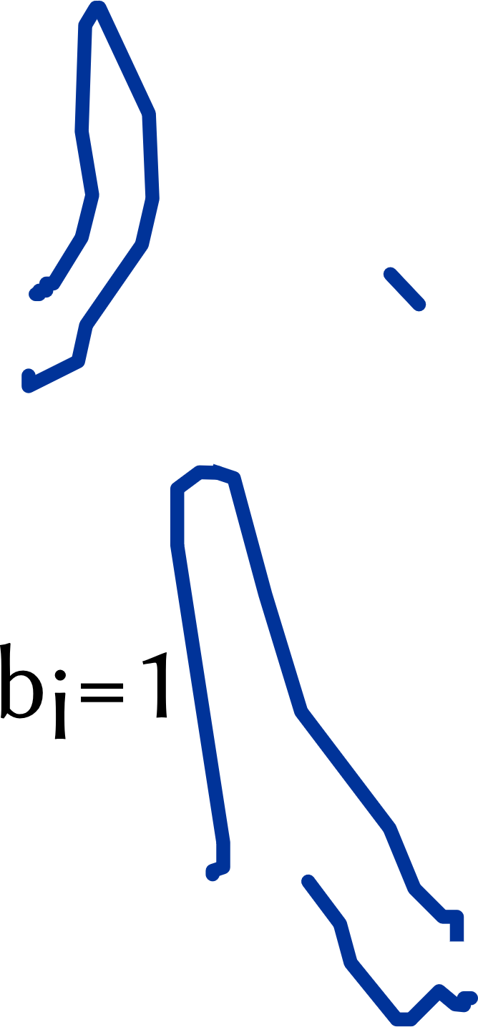
Topology optimization
Discrete-continuous optimization
Inspired by 2018, Li, OptCuts: Joint Optimization of Surface Cuts and Parameterization
Notes:
Starting with an initial mesh without any cuts and the initial [pose], deforming it into a [different] pose often fails to [produce] the desired result. For example, the left hand may remain "glued" to the body, causing extreme texture distortions. This issue is visualized using Dirichlet energy, where low values are shown in gray and high values in red.
[To] address this, our goal is to construct a 2.5D template with the correct (корЭкт) topology, allowing elements like the left hand to move freely to any position. This template ensures (эншЮрс) that deformations driven by skeletal animation remain smooth.
[To] achieve this, we segment the boundary of each occlusion region into three types of edges: [visible] occlusion contours (red), [hidden] contours (blue), and [non-manifold] edges (yellow). We then [cut] the initial template pockets along the visible and hidden contours.
[Inspired] by OptCuts, we assign a binary variable (вЭреэбл) B to each edge of an occlusion boundary, distinguishing between visible and hidden contours. We solve a [discrete-continuous] optimization problem to minimize the symmetric Dirichlet energy of the deformation and the L2 distance between skeletons.
[Suboptimal] assignments of binary variables lead to high-energy regions and distortions. [In] contrast (кОнтраст), the optimal assignment results in a smooth and visually correct (корЭкт) deformation.

Slide 16
Topology optimization
Cut the mesh via deformation
Notes:
And we get the optimized topology with the textured mesh.

Slide 17
Algorithm overview
Notes:
[Finally]

Slide 18
Frame interpolation
Notes:
When working with a textured mesh with the correct (корЭкт) topology, we can smoothly deform it to match a [given] skeletal pose. We deform the [first] keyframe, then the [second] one which results in two frames, both in the same pose but with different textures. The final step is to [blend] these textures to generate the in-between frame, which we achieve through a blending optimization process.

Slide 19
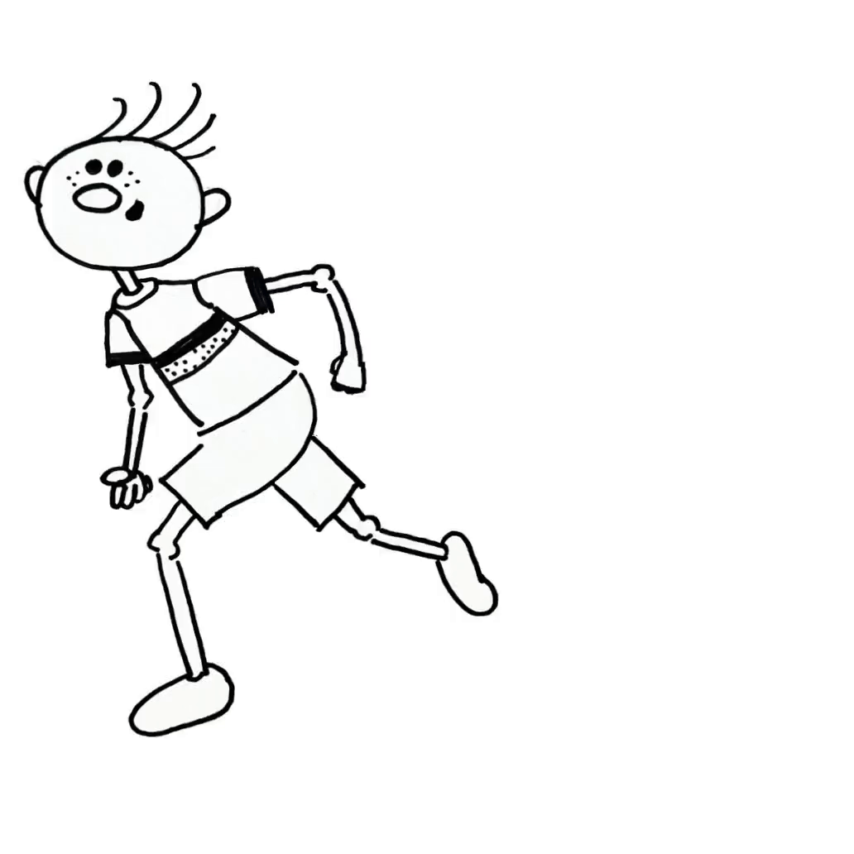
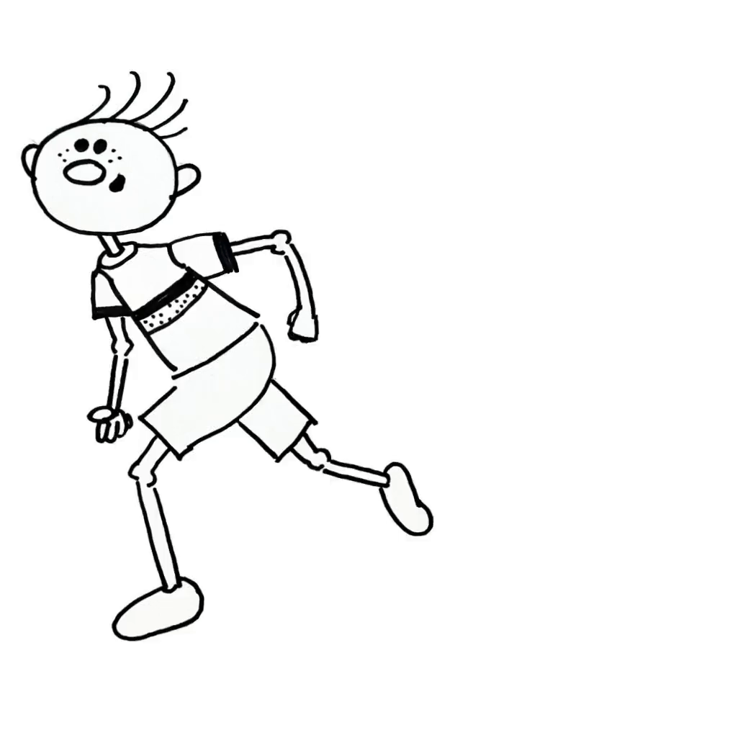
Blending optimization
x
v
Notes:
The blending optimization technique allows for the selection of sharper and clearer intermediate frames, ensuring smooth and seamless transitions. In contrast (кОнтраст), a naïve approach often leads to [ghosting] artifacts on the right elbow, as illustrated here.

Slide 20
Results
Input frame A
Output
Input frame B
Notes:
Here are the results: the left arm and leg are accurately segmented, and the interpolation between the two drawings is precise.

Slide 21
Results
Input frame A
Output
Input frame B
Notes:
In this example, the arms are in opposite positions in the first and second keyframes. Again, the algorithm produces a smooth motion.

Slide 22
Results
Input frame A
Output
Input frame B
Notes:
In this example, the girl experiences multiple occlusions. Our method accurately separates the right hand from the body, as well as the left arm and legs from the skirt, ensuring precise interpolation between the two drawings.

Slide 23
Conclusion
Skeleton-Driven Inbetweening of Bitmap Character Drawings
User control
Sparse keyframes
Occlusions
Notes:
In conclusion, we [introduced] and validated a novel method for bitmap character inbetweening, offering [artistic] control via a skeleton animation. Our method successfully performs inbetweening for [distant] keyframes, with or without [occlusions], with vastly different geometry and topology. Thank you for your attention.

