Slide 1
Arbres des suffixes
Nadia El-Mabrouk

Slide 2
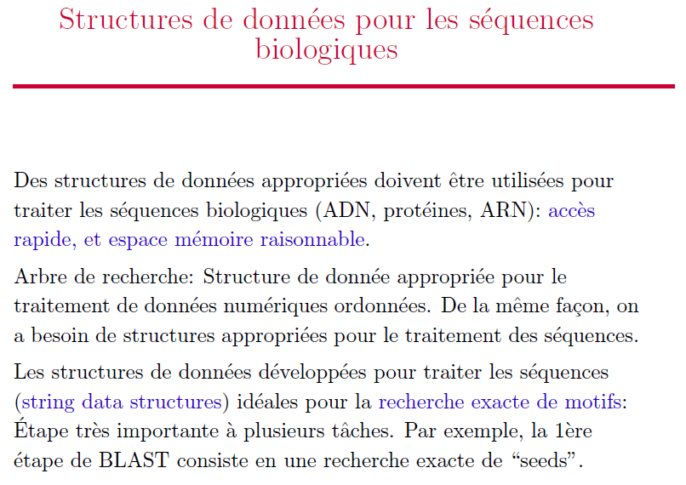

Slide 3
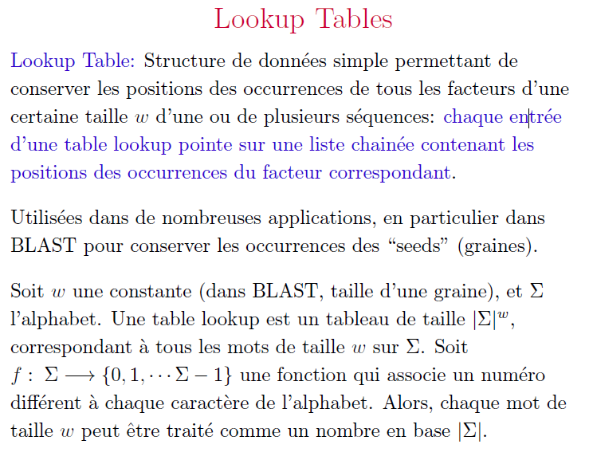

Slide 4
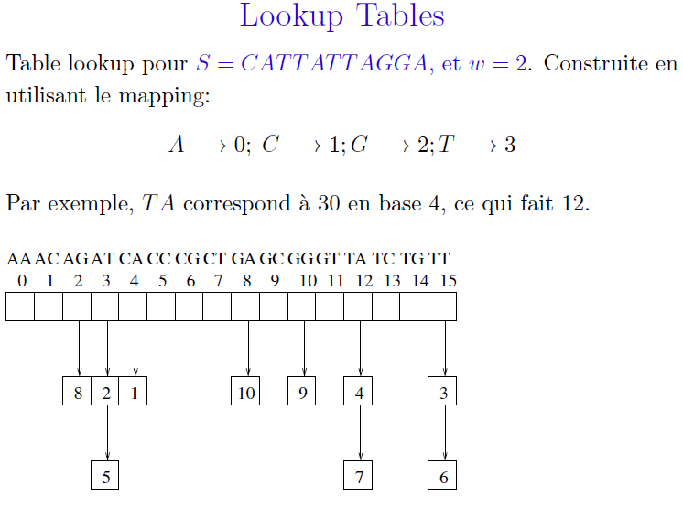

Slide 5
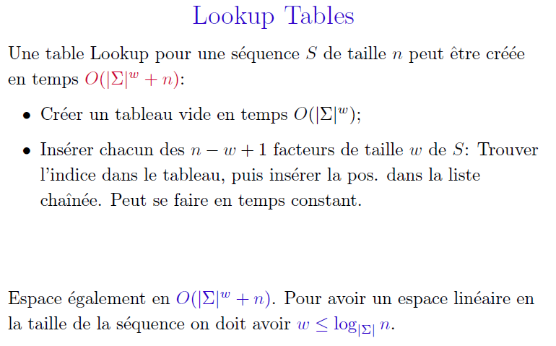

Slide 6
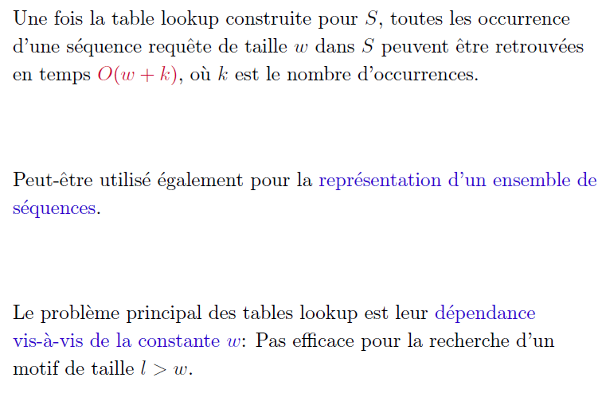

Slide 7
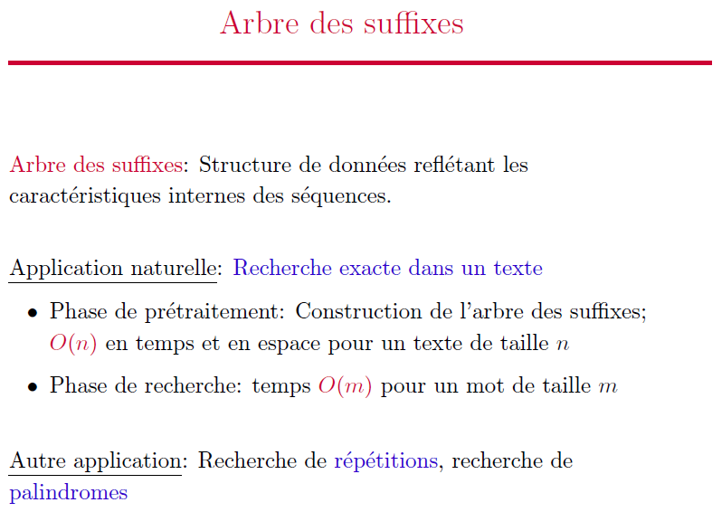

Slide 8
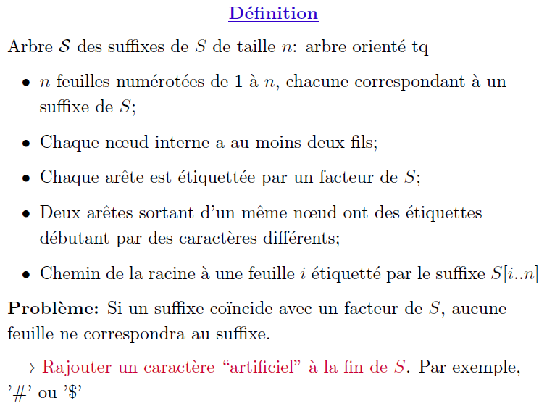

Slide 9
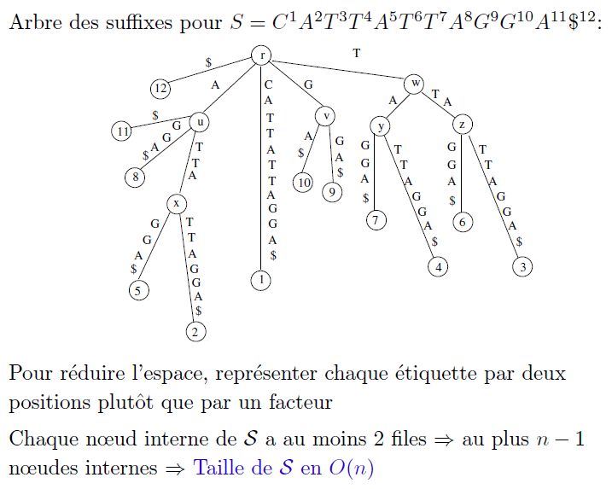
fils

Slide 10
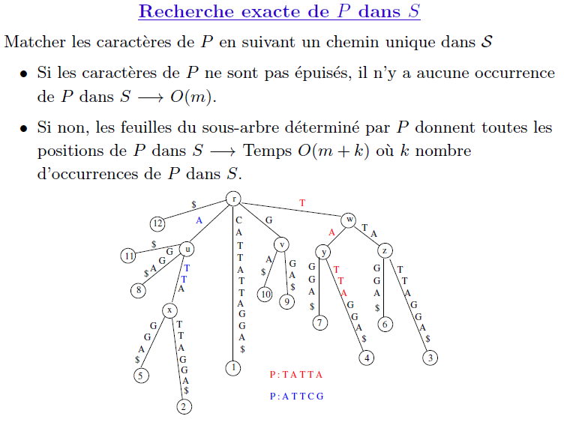

Slide 11
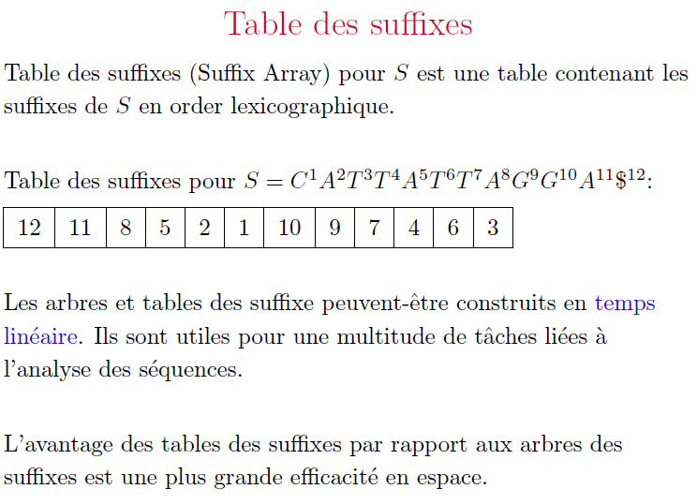

Slide 12
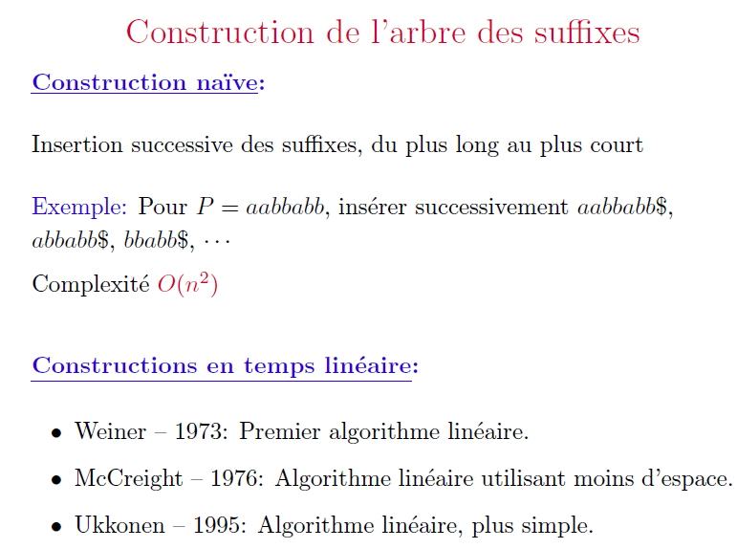

Slide 13
 | 1 | 2 | 3 | 4 | 5 | 6 | 7
S₁: | A | G | A | G | G | A | G

Slide 14
 | 1 | 2 | 3 | 4 | 5 | 6 | 7
S₁: | A | G | A | G | G | A | G
A G A G G A G
1

Slide 15
 | 1 | 2 | 3 | 4 | 5 | 6 | 7
S₁: | A | G | A | G | G | A | G
A G A G G A G
G A G G A G
1
2

Slide 16
 | 1 | 2 | 3 | 4 | 5 | 6 | 7
S₁: | A | G | A | G | G | A | G
A G A G G A G
G A G G A G
G A G
3
1
2

Slide 17
 | 1 | 2 | 3 | 4 | 5 | 6 | 7
S₁: | A | G | A | G | G | A | G
G A G
4
A G A G G A G
G A G G A G
G A G
3
1
2

Slide 18
 | 1 | 2 | 3 | 4 | 5 | 6 | 7 | 8
S₁: | A | G | A | G | G | A | G | #
G A G #
4
A G A G G A G #
G A G G A G #
G A G #
3
1
2

Slide 19
 | 1 | 2 | 3 | 4 | 5 | 6 | 7 | 8
S₁: | A | G | A | G | G | A | G | #
G A G #
4
A G A G G A G #
G A G G A G #
#
5
G A G #
3
1
2

Slide 20
 | 1 | 2 | 3 | 4 | 5 | 6 | 7 | 8
S₁: | A | G | A | G | G | A | G | #
G A G #
4
#
6
A G A G G A G #
G A G G A G #
#
5
G A G #
3
1
2

Slide 21
 | 1 | 2 | 3 | 4 | 5 | 6 | 7 | 8
S₁: | A | G | A | G | G | A | G | #
7
#
G A G #
4
#
6
A G A G G A G #
G A G G A G #
#
5
G A G #
3
1
2

Slide 22
 | 1 | 2 | 3 | 4 | 5 | 6 | 7 | 8
S₁: | A | G | A | G | G | A | G | #
7
[8]
[5,8]
4
[8]
[1,2] [3,8]
6
[2] [3,4] [5,8]
[8]
5
[5,8]
3
1
2

Slide 25
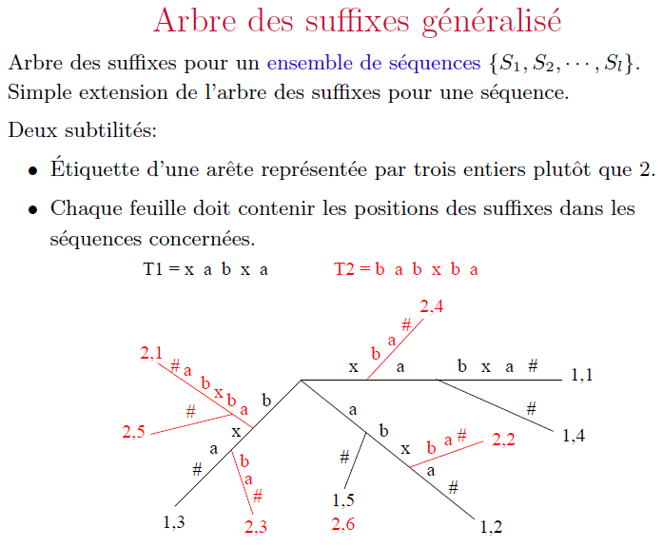

Slide 26
 | 1 | 2 | 3 | 4 | 5 | 6 | 7 | 8
S₁: | A | G | A | G | G | A | G | #
 | 1 | 2 | 3 | 4 | 5 | 6 | 7 | 8
S₂: | G | G | A | C | G | C | A | #
A #
6
7
#
C G C A #
4
G A G #
#
4
7
C G C A #
C G C A #
C A #
#
3
A G A G G A G #
1
G A G G A G #
C G C A #
6
#
5
G A G #
2
5
2
3
1

Slide 27
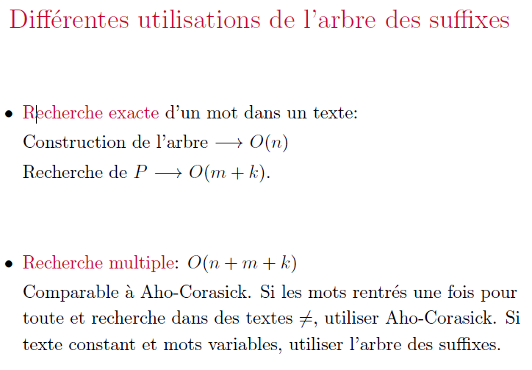

Slide 28
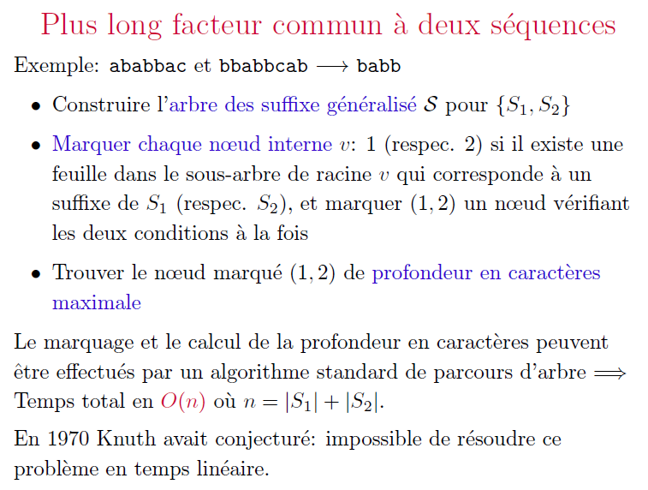

Slide 29
Plus long facteur commun
 | 1 | 2 | 3 | 4 | 5 | 6 | 7 | 8
S₁: | A | G | A | G | G | A | G | #
 | 1 | 2 | 3 | 4 | 5 | 6 | 7 | 8
S₂: | G | G | A | C | G | C | A | #
A #
6
7
#
C G C A #
4
G A G #
#
4
7
C G C A #
C G C A #
C A #
#
3
A G A G G A G #
1
G A G G A G #
C G C A #
6
#
5
G A G #
2
5
2
3
1

Slide 30
Plus long facteur commun
 | 1 | 2 | 3 | 4 | 5 | 6 | 7 | 8
S₁: | A | G | A | G | G | A | G | #
Marquer les nœuds internes
 | 1 | 2 | 3 | 4 | 5 | 6 | 7 | 8
S₂: | G | G | A | C | G | C | A | #
A #
6
7
(1,2)
#
C G C A #
(1,2)
4
G A G #
#
(1,2)
7
4
(1,2)
C G C A #
(1,2)
C A #
C G C A #
#
(1)
3
A G A G G A G #
1
G A G G A G #
(1)
6
C G C A #
5
#
G A G #
2
5
2
3
1

Slide 31
Plus long facteur commun
 | 1 | 2 | 3 | 4 | 5 | 6 | 7 | 8
S₁: | A | G | A | G | G | A | G | #
Marquer les nœuds internes et profondeur en caractères
 | 1 | 2 | 3 | 4 | 5 | 6 | 7 | 8
S₂: | G | G | A | C | G | C | A | #
A #
6
7
(1,2)
(2)
#
C G C A #
1
(1,2)
4
G A G #
#
(1,2)
1
7
4
1
3
(1,2)
C G C A #
(1,2)
C A #
C G C A #
2
2
#
(1)
3
A G A G G A G #
G A G G A G #
1
3
(1)
6
C G C A #
5
#
G A G #
2
5
2
3
1

Slide 32
Plus long facteur commun
 | 1 | 2 | 3 | 4 | 5 | 6 | 7 | 8
S₁: | A | G | A | G | G | A | G | #
Marquer les nœuds internes et profondeur en caractères
Prendre nœuds marqués (1,2) de profondeur en caractère max
 | 1 | 2 | 3 | 4 | 5 | 6 | 7 | 8
S₂: | G | G | A | C | G | C | A | #
A #
6
7
(1,2)
(2)
#
C G C A #
1
(1,2)
4
G A G #
#
(1,2)
1
7
4
1
3
(1,2)
C G C A #
(1,2)
C A #
C G C A #
2
2
#
(1)
3
A G A G G A G #
G A G G A G #
1
3
(1)
6
C G C A #
5
#
G A G #
2
5
2
3
1

Slide 33
Répétitions maximales et supermaximales
 | 1 | 2 | 3 | 4 | 5 | 6 | 7 | 8
S₁: | A | G | A | G | G | A | G | #
7
#
G A G #
4
#
6
A G A G G A G #
G A G G A G #
#
5
G A G #
3
1
2

Slide 34
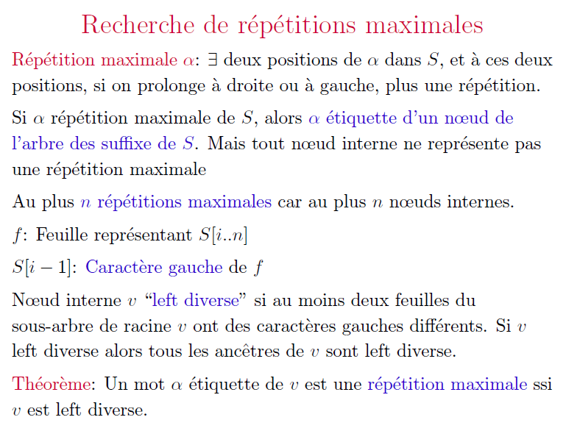

Slide 35
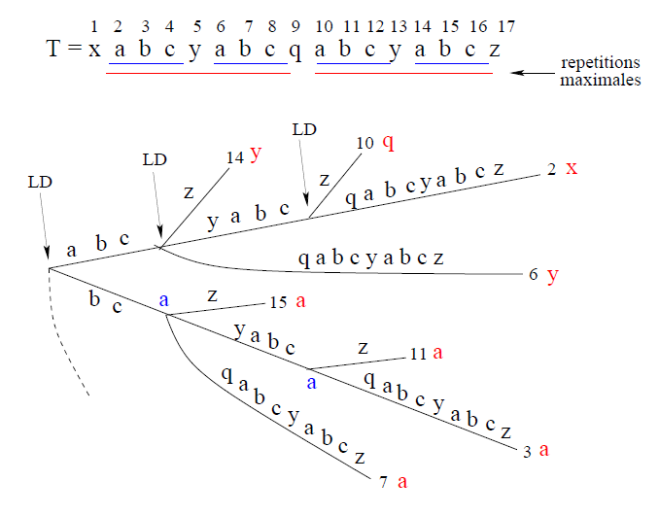

Slide 36
Répétitions maximales
r

Slide 37
Répétitions maximales
r

Slide 38
Pas répétition maximale
r

Slide 39
Pas répétition maximale
r

Slide 41
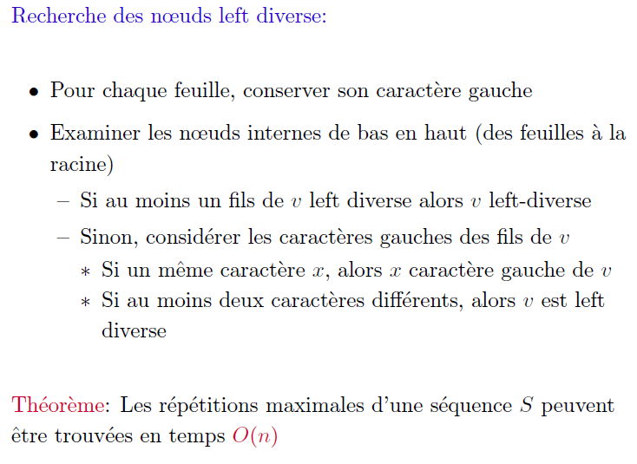

Slide 43
Répétitions maximales
 | 1 | 2 | 3 | 4 | 5 | 6 | 7 | 8
S₁: | A | G | A | G | G | A | G | #
7
#
G A G #
4
#
6
A G A G G A G #
G A G G A G #
#
5
G A G #
3
1
2

Slide 44
Répétitions maximales
Étiqueter les feuilles par le caractère gauche
 | 1 | 2 | 3 | 4 | 5 | 6 | 7 | 8
S₁: | A | G | A | G | G | A | G | #
A
7
#
G A G #
A
4
#
6
G
A G A G G A G #
G A G G A G #
#
5
G
G A G #
3
1
$
2
G
A

Slide 45
Répétitions maximales
Étiqueter les feuilles par le caractère gauche
Étiqueter les nœuds internes
 | 1 | 2 | 3 | 4 | 5 | 6 | 7 | 8
S₁: | A | G | A | G | G | A | G | #
A
7
#
G A G #
A
4
LD
LD
#
6
G
LD
A G A G G A G #
G A G G A G #
#
5
G
G A G #
3
1
$
2
G
A

Slide 46
Répétitions maximales
Étiqueter les feuilles par le caractère gauche
Étiqueter les nœuds internes
Les nœuds LD correspondent aux répétitions max
 | 1 | 2 | 3 | 4 | 5 | 6 | 7 | 8
S₁: | A | G | A | G | G | A | G | #
A
7
#
G A G #
A
4
LD
LD
#
6
G
LD
A G A G G A G #
G A G G A G #
#
5
G
G A G #
3
1
$
2
G
A

Slide 47
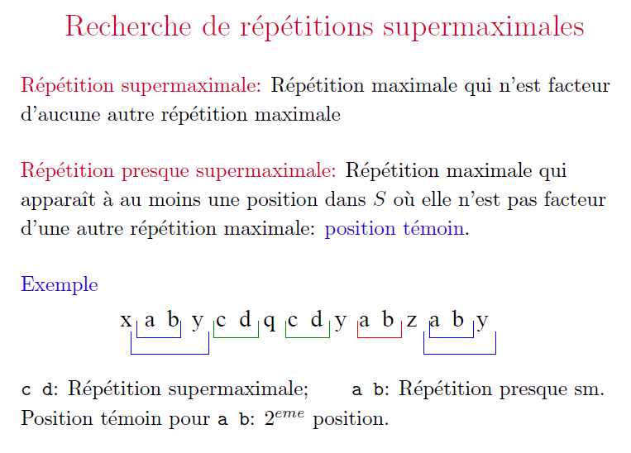

Slide 48
Répétitions presque-supermaximales
 | 1 | 2 | 3 | 4 | 5 | 6 | 7 | 8
S₁: | A | G | A | G | G | A | G | #
7
#
G A G #
4
LD
LD
#
6
LD
A G A G G A G #
G A G G A G #
#
5
G A G #
3
1
2

Slide 49
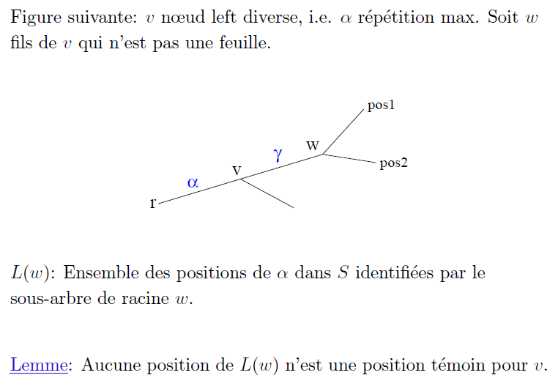

Slide 50
Répétitions presque-supermaximales
 | 1 | 2 | 3 | 4 | 5 | 6 | 7 | 8
S₁: | A | G | A | G | G | A | G | #
7
Pas des positions témoin
#
V
G A G #
4
LD
LD
#
6
LD
A G A G G A G #
G A G G A G #
W
#
5
G A G #
3
1
2

Slide 51
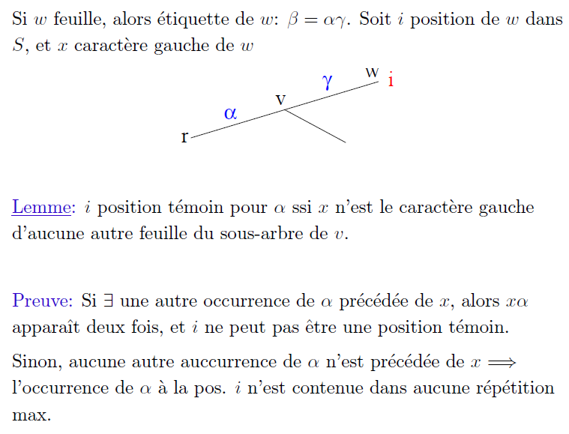

Slide 52
Répétitions presque-supermaximales
 | 1 | 2 | 3 | 4 | 5 | 6 | 7 | 8
S₁: | A | G | A | G | G | A | G | #
A
7
Pas une position témoin
#
G n’est pas une répétition
presque- supermaximale
i
G A G #
V
A
4
#
6
G
A G A G G A G #
G A G G A G #
#
5
G
G A G #
3
1
$
2
G
A

Slide 53
Répétitions presque-supermaximales
 | 1 | 2 | 3 | 4 | 5 | 6 | 7 | 8
S₁: | A | G | A | G | G | A | G | #
A
7
Position témoin
#
AG est une répétition
presque- supermaximale
G A G #
A
4
#
V
6
G
A G A G G A G #
G A G G A G #
#
5
G
G A G #
i
3
1
$
2
G
A

Slide 54
Répétitions presque-supermaximales
 | 1 | 2 | 3 | 4 | 5 | 6 | 7 | 8
S₁: | A | G | A | G | G | A | G | #
A
7
GAG est une répétition
presque- supermaximale
#
G A G #
A
4
#
6
G
V
A G A G G A G #
G A G G A G #
#
5
G
G A G #
i
3
1
$
2
G
A

Slide 55
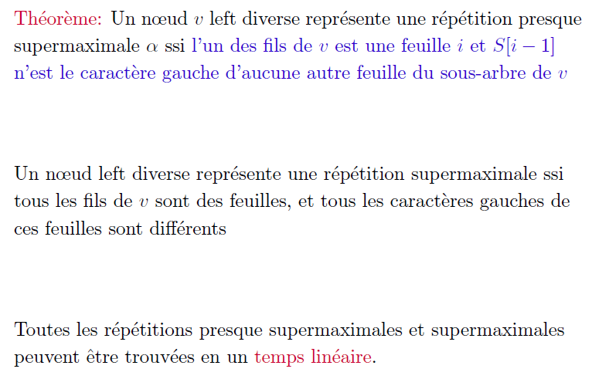

Slide 56
Répétitions supermaximales
 | 1 | 2 | 3 | 4 | 5 | 6 | 7 | 8
S₁: | A | G | A | G | G | A | G | #
A
7
#
G A G #
A
4
LD
LD
#
6
G
LD
A G A G G A G #
G A G G A G #
#
5
G
G A G #
3
1
$
2
G
A

Slide 57
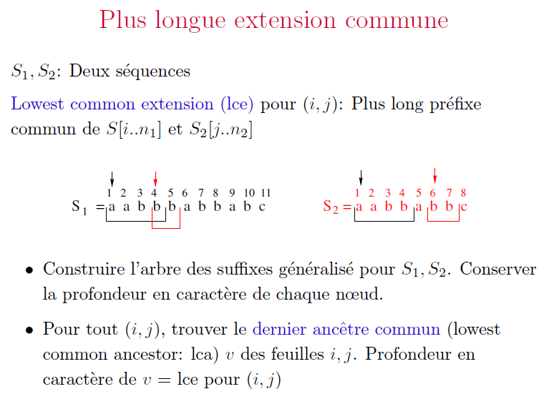

Slide 59
Plus longue extension commune
 | 1 | 2 | 3 | 4 | 5 | 6 | 7 | 8
S₁: | A | G | A | G | G | A | G | #
 | 1 | 2 | 3 | 4 | 5 | 6 | 7 | 8
S₂: | G | G | A | G | G | C | A | #
4
7
C A #
C A #
#
6
#
G A G #
7
4
C A #
#
6
A G A G G A G #
G C A #
G A G G A G #
5
#
C A #
5
G A G #
1
C A #
2
3
1
2
3

Slide 61
Plus longue extension commune
 | 1 | 2 | 3 | 4 | 5 | 6 | 7 | 8
S₁: | A | G | A | G | G | A | G | #
Profondeur en caractère du dernier ancêtre commun
 | 1 | 2 | 3 | 4 | 5 | 6 | 7 | 8
S₂: | G | G | A | G | G | C | A | #
4
7
C A #
C A #
#
6
1
#
2
1
7
G A G #
4
4
2
#
C A #
6
3
A G A G G A G #
G C A #
G A G G A G #
3
#
5
4
C A #
5
G A G #
1
C A #
2
3
1
2
3

Slide 62
Plus longue extension commune
 | 1 | 2 | 3 | 4 | 5 | 6 | 7 | 8
S₁: | A | G | A | G | G | A | G | #
Profondeur en caractère du dernier ancêtre commun
 | 1 | 2 | 3 | 4 | 5 | 6 | 7 | 8
S₂: | G | G | A | G | G | C | A | #
4
7
C A #
C A #
#
6
1
#
2
1
7
G A G #
4
4
2
#
C A #
6
3
A G A G G A G #
G C A #
G A G G A G #
3
#
5
4
C A #
5
G A G #
1
C A #
2
3
1
2
3

Slide 63
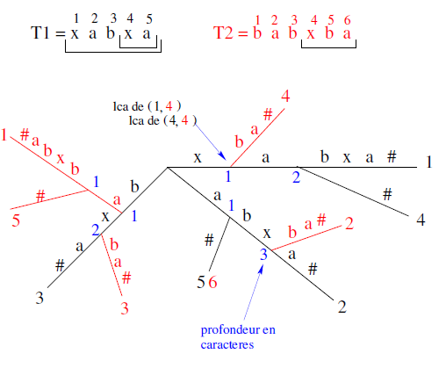

Slide 64
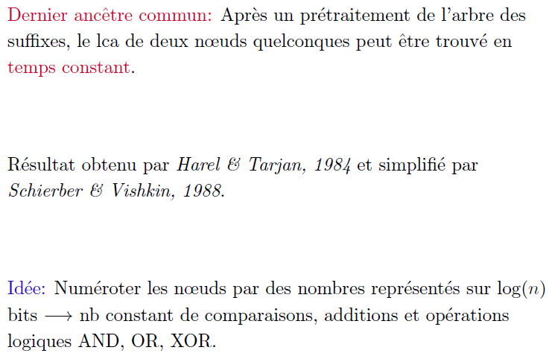

Slide 65
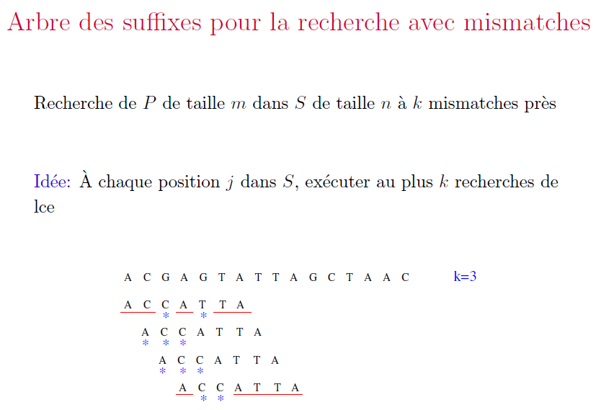

Slide 66
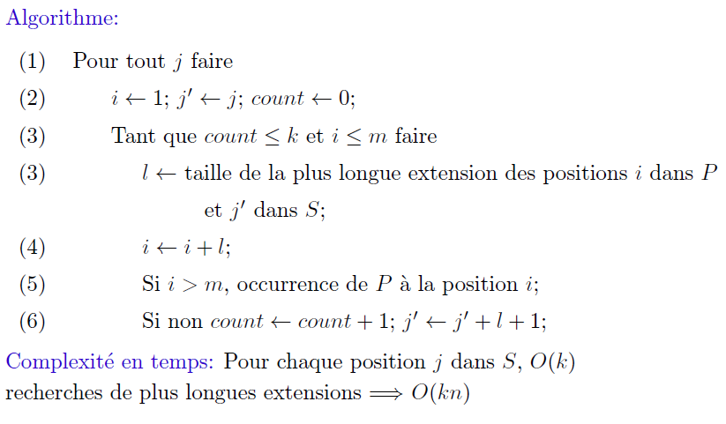

Slide 67
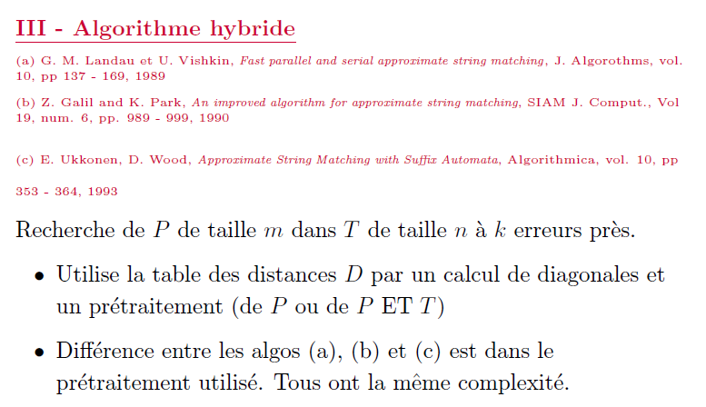

Slide 68
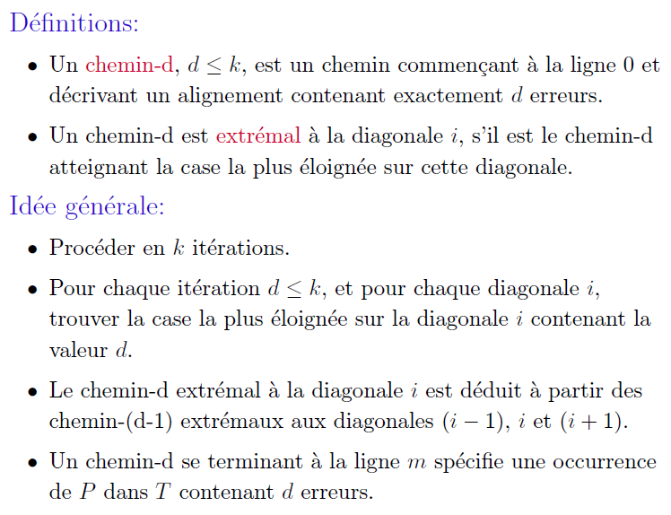

Slide 69
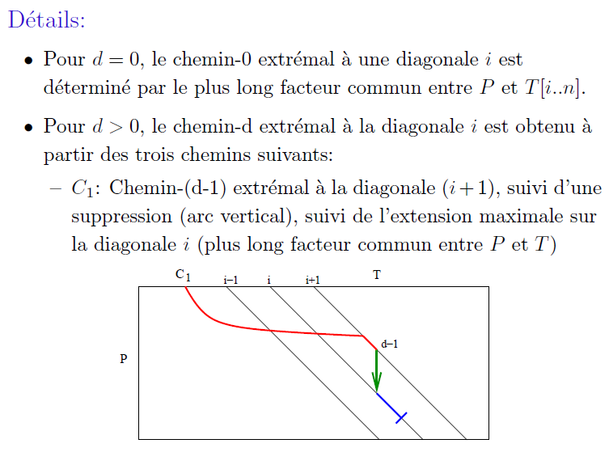

Slide 70
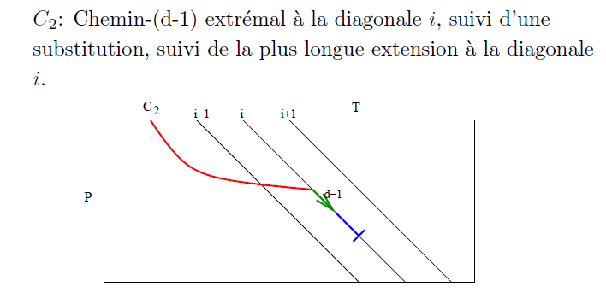

Slide 71
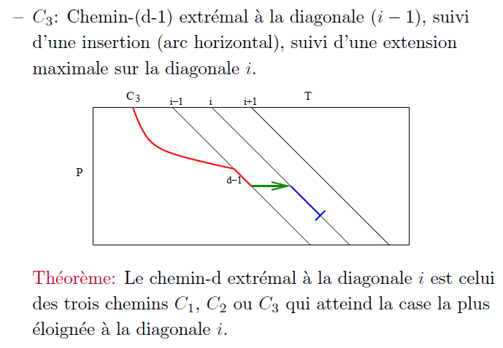

Slide 72
T
D |  | G | T | C | G | A | T | T | A | T
G
T
A
T
P
Recherche de P dans T à 1 erreur près.

Slide 73
T
0 1 2 3 4 5 6 7 8 9
D |  | G | T | C | G | A | T | T | A | T
G
T
A
T
-1
P
-2
-3
-4
Recherche de P dans T à 1 erreur près.

Slide 74
d=0
i=0
T
0 1 2 3 4 5 6 7 8 9
D |  | G ¹ | T ² | C ³ | G ⁴ | A ⁵ | T ⁶ | T ⁷ | A ⁸ | T ⁹
G
T |  |  | 0
A
T
-1
P
-2
-3
-4

Slide 75
d=0
i=1
T
0 1 2 3 4 5 6 7 8 9
D |  | G ¹ | T ² | C ³ | G ⁴ | A ⁵ | T ⁶ | T ⁷ | A ⁸ | T ⁹
 |  | 0
G
T |  |  | 0
A
T
-1
P
-2
-3
-4

Slide 76
d=0
i=2
T
0 1 2 3 4 5 6 7 8 9
D |  | G ¹ | T ² | C ³ | G ⁴ | A ⁵ | T ⁶ | T ⁷ | A ⁸ | T ⁹
 |  | 0 | 0
G
T |  |  | 0
A
T
-1
P
-2
-3
-4

Slide 77
d=0
i=3
T
0 1 2 3 4 5 6 7 8 9
D |  | G ⁰ | T ¹ | C ² | G ³ | A ⁴ | T ⁵ | T ⁶ | A ⁷ | T ⁸
 |  | 0 | 0
G |  |  |  |  | 0
T |  |  | 0
A
T
-1
P
-2
-3
-4

Slide 78
d=0
T
0 1 2 3 4 5 6 7 8 9
D |  | G ¹ | T ² | C ³ | G ⁴ | A ⁵ | T ⁶ | T ⁷ | A ⁸ | T ⁹
 |  | 0 | 0 |  | 0 | 0 | 0 | 0 | 0 | 0
G |  |  |  |  | 0
T |  |  | 0
A
T
-1
P
-2
-3
-4

Slide 79
d=1
i=-1
T
0 1 2 3 4 5 6 7 8 9
D |  | G ¹ | T ² | C ³ | G ⁴ | A ⁵ | T ⁶ | T ⁷ | A ⁸ | T ⁹
 |  | 0 | 0 |  | 0 | 0 | 0 | 0 | 0 | 0
G |  |  |  |  | 0
T |  |  | 0
A |  |  | 1
T
-1
P
-2
-3
C₁
-4

Slide 80
d=1
i=0
T
0 1 2 3 4 5 6 7 8 9
D |  | G ¹ | T ² | C ³ | G ⁴ | A ⁵ | T ⁶ | T ⁷ | A ⁸ | T ⁹
 |  | 0 | 0 |  | 0 | 0 | 0 | 0 | 0 | 0
G |  |  |  |  | 0
T |  |  | 0
A |  |  | 1 | 1
T
-1
P
-2
C₁
-3
C₂
-4

Slide 81
d=1
i=1
T
0 1 2 3 4 5 6 7 8 9
D |  | G ¹ | T ² | C ³ | G ⁴ | A ⁵ | T ⁶ | T ⁷ | A ⁸ | T ⁹
 |  | 0 | 0 |  | 0 | 0 | 0 | 0 | 0 | 0
G |  |  |  |  | 0
T |  |  | 0 | 1
A |  |  | 1 | 1
T
-1
P
-2
C₁
C₂
-3
C₃
-4

Slide 82
d=1
i=1
T
0 1 2 3 4 5 6 7 8 9
D |  | G ¹ | T ² | C ³ | G ⁴ | A ⁵ | T ⁶ | T ⁷ | A ⁸ | T ⁹
 |  | 0 | 0 |  | 0 | 0 | 0 | 0 | 0 | 0
G |  |  |  |  | 0
T |  |  | 0 | 1
A |  |  | 1 | 1
T |  |  |  |  |  |  | 1
-1
P
C₃
C₂
-2
-3
C₁
-4

Slide 83
d=1
i=1
T
0 1 2 3 4 5 6 7 8 9
D |  | G ¹ | T ² | C ³ | G ⁴ | A ⁵ | T ⁶ | T ⁷ | A ⁸ | T ⁹
 |  | 0 | 0 |  | 0 | 0 | 0 | 0 | 0 | 0
G |  |  |  |  | 0
T |  |  | 0 | 1 |  | 1
A |  |  | 1 | 1
T |  |  |  |  |  |  | 1
-1
P
C₃
C₁
-2
-3
C₂
-4

Slide 84
d=1
i=1
T
0 1 2 3 4 5 6 7 8 9
D |  | G ¹ | T ² | C ³ | G ⁴ | A ⁵ | T ⁶ | T ⁷ | A ⁸ | T ⁹
 |  | 0 | 0 |  | 0 | 0 | 0 | 0 | 0 | 0
G |  |  |  |  | 0
T |  |  | 0 | 1 |  | 1 | 1
A |  |  | 1 | 1
T |  |  |  |  |  |  | 1
-1
P
C₂
-2
C₁
C₃
-3
-4

Slide 85
d=1
i=1
T
0 1 2 3 4 5 6 7 8 9
D |  | G ¹ | T ² | C ³ | G ⁴ | A ⁵ | T ⁶ | T ⁷ | A ⁸ | T ⁹
 |  | 0 | 0 |  | 0 | 0 | 0 | 0 | 0 | 0
G |  |  |  |  | 0
T |  |  | 0 | 1 |  | 1 | 1
A |  |  | 1 | 1
T |  |  |  |  |  |  | 1 |  |  | 1
-1
P
C₃
-2
C₂
C₁
-3
-4

Slide 86
d=1
i=1
T
D |  | G ¹ | T ² | C ³ | G ⁴ | A ⁵ | T ⁶ | T ⁷ | A ⁸ | T ⁹
 |  | 0 | 0 |  | 0 | 0 | 0 | 0 | 0 | 0
G |  |  |  |  | 0
T |  |  | 0 | 1 |  | 1 | 1
A |  |  | 1 | 1
T |  |  |  |  |  |  | 1 |  |  | 1
P

Slide 87
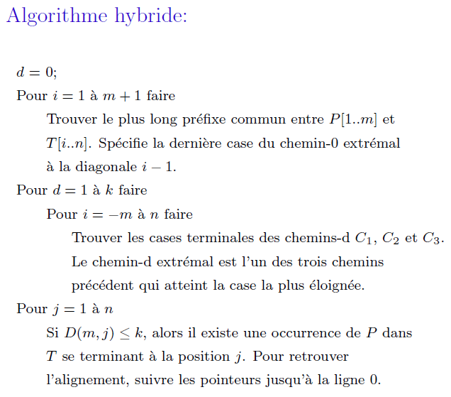

Slide 88
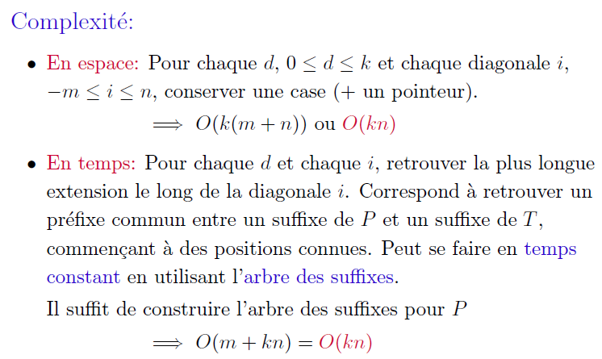

Slide 89
Références
Algorithms on Strings, Trees and Sequences – Computer science and Computational biology, Dan Gusfield, Cambridge University Press, 1997. Partie II
Handbook of Computational Molecular Biology, Srinivas Aluru ed., Chapman & Hall/CRC Computer and Information Science Series, 2005. Partie II. (Voir également chapitre 35)

